Slide 1
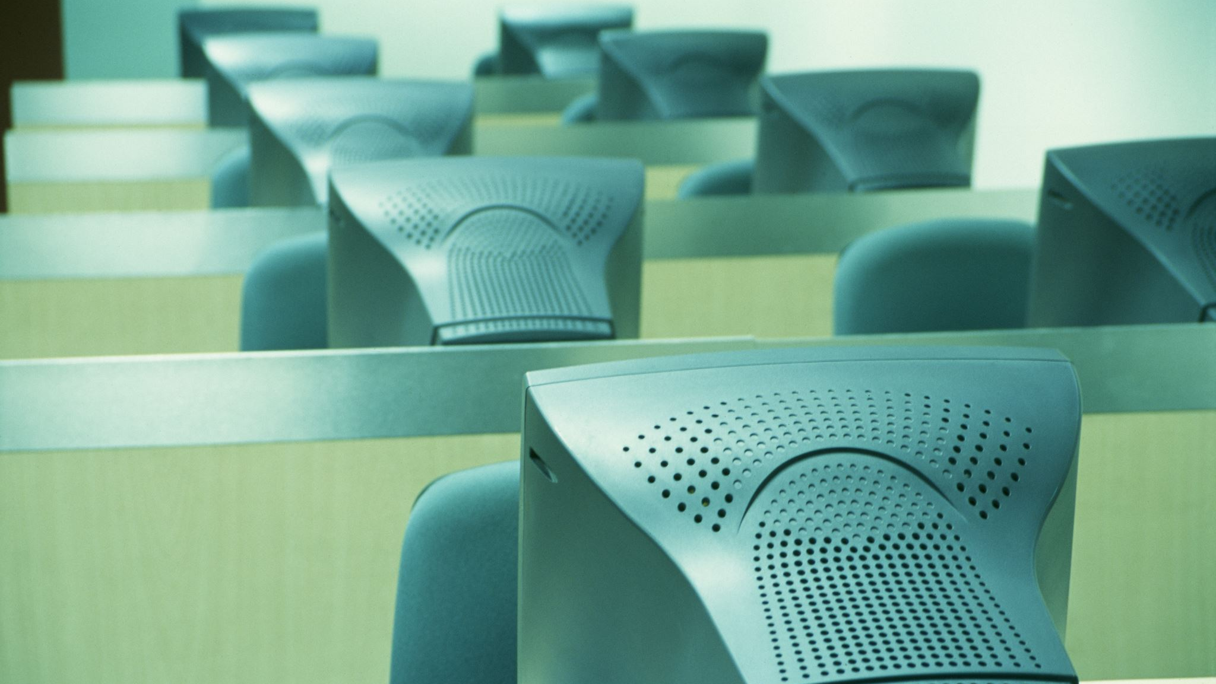
“The Computer Stand”
Literacy Objects as Material Culture in Times of Despair and Hope
Hannah J. Rule, University of South Carolina ruleh @ mailbox.sc.edu | hannahjrule . com

Slide 2
I. DESCRIPTION
Officially the stand’s dimensions are listed as 14.6 x 9.3 inches, and 3.9 to 5.5 inches in height

Slide 3
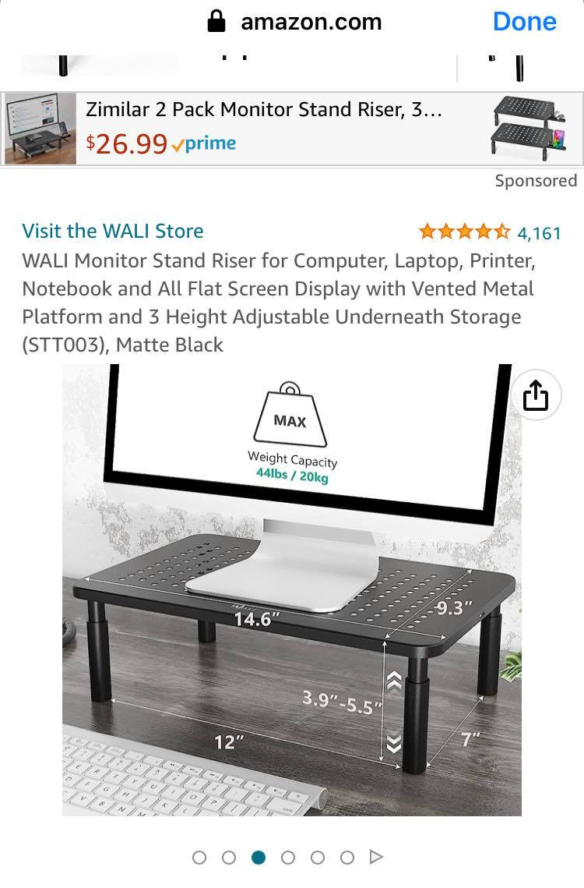
II. Intro
“engag[ing] the other culture in the first instance not with our minds, the seat of our cultural biases, but with our senses” (Prown, “Mind in Matter” 5)

Slide 4
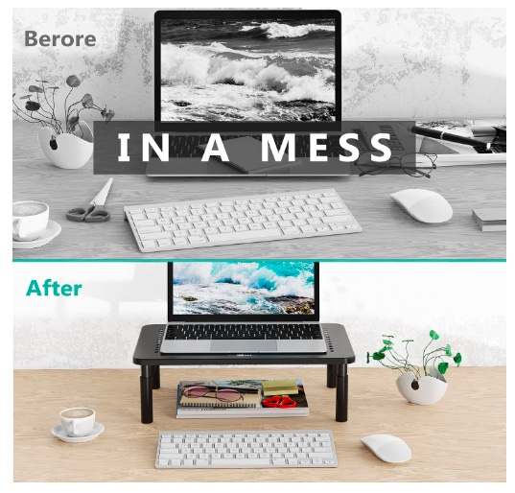
III. Deduction
“It is now possible to entertain hypotheses concerning what your chosen object signifies, what it suggests about the world in which it circulates or circulated--a world which, in some sense, metonymically, it represents. . . Out of what matrix of contested meanings—tensions, ambiguities, and contradiction—is its broadest meaning generated?”
(Haltman, “Introduction,” American Artifacts, 6)
Image captured from amazon.com, on product page for “WALI Monitor Stand Riser for Computer, Laptop, Printer, Notebook and All Flat Screen Display with Vented Metal Platform and 3 Height Adjustable Underneath Storage (STT003), Matte Black.” This is the stand I bought. Most of the images and information on this page is about use as a monitor stand, to raise a screen to eye-level for better posture.

Slide 5
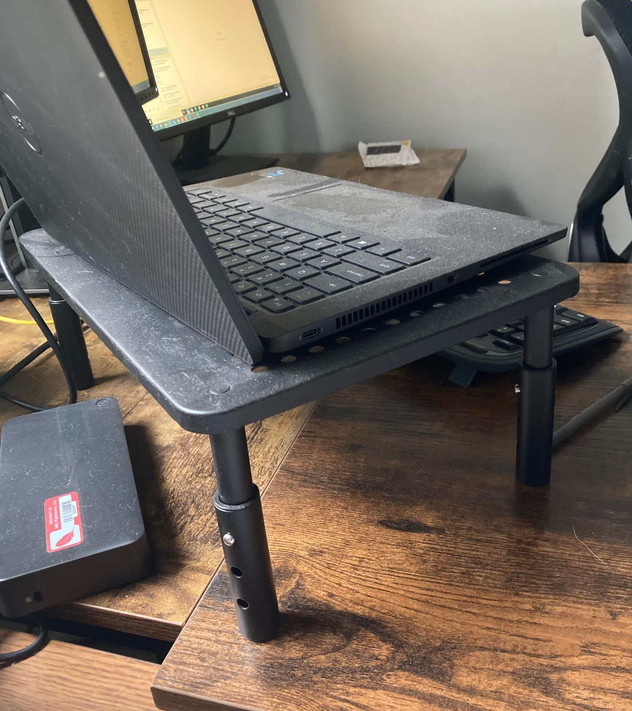
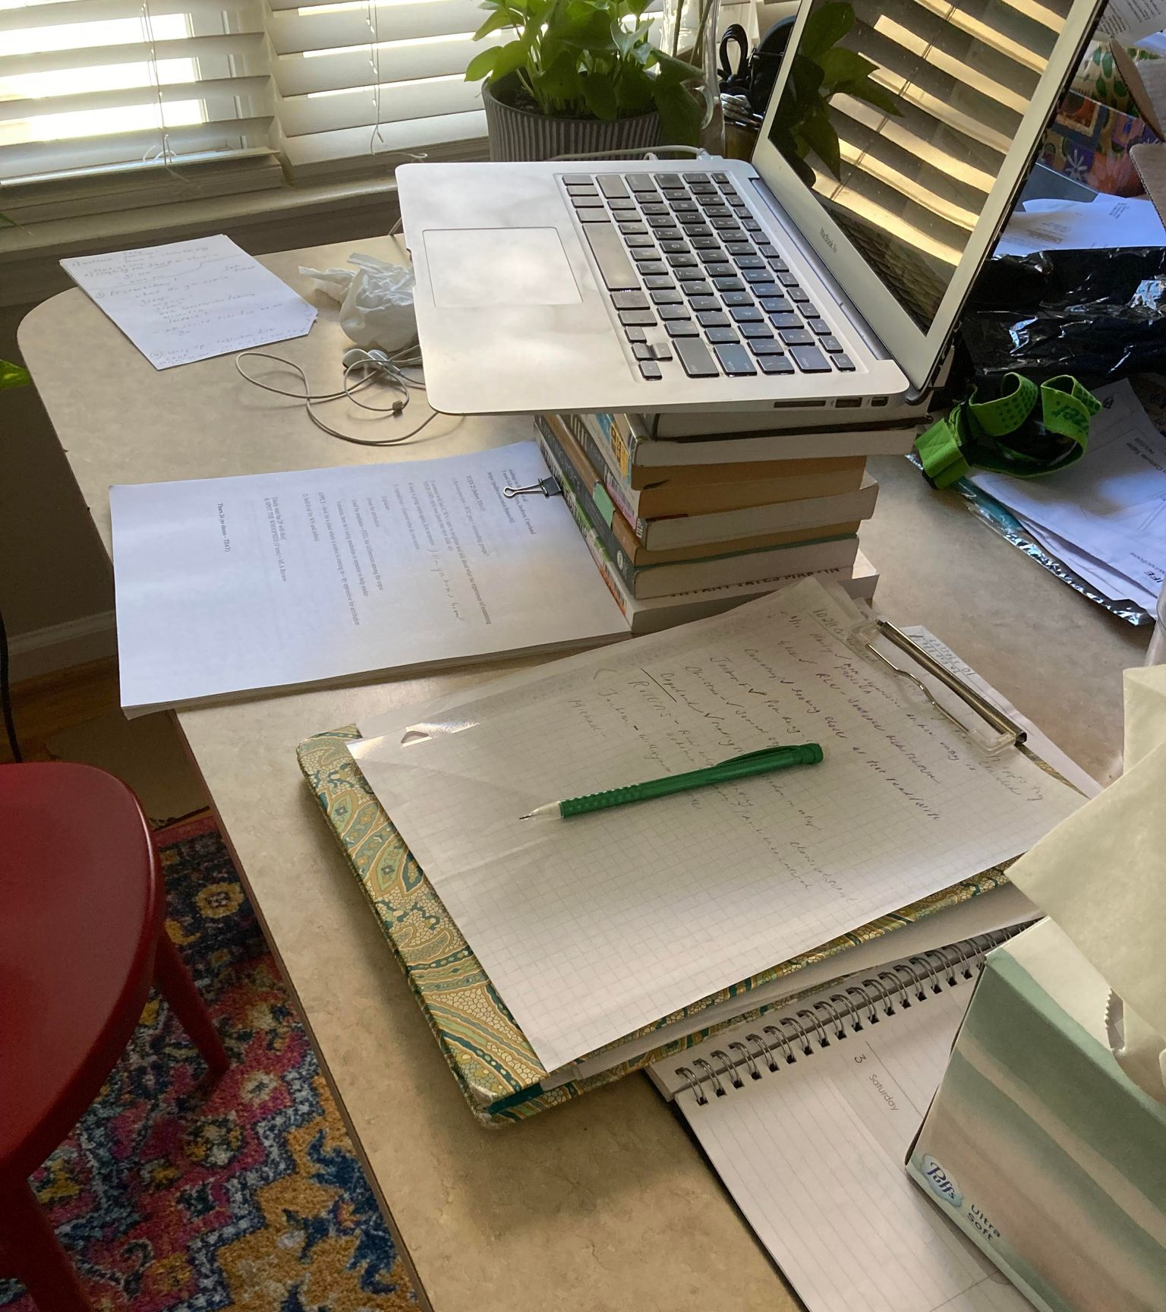
IV. Speculation
Mihaly Csikszentmihalyi, “Why We Need Things” History from Things: Essays on Material Culture (1993)
“Whenever someone buys a new food processor, that person is not expressing an essential human need but acting in terms of a consciousness shaped by appliances” (21)
“Most of the things we make these days do not make life better in any material sense but instead serve to stabilize and order the mind” (22)
My “stand” now – an ad hoc pile of books on a dining table
The Stand, now—on my husband’s desk

